Slide 1
Beneficial use of dredgings from a future Haven Navigation Channel deepening project February 2014

Slide 2
Harwich Haven Authority and the Port of Felixstowe are working together on the early stages of a Haven Navigation Channel deepening project. During 2011 and 2012 we undertook;
Assessment of current channel capacity and the benefits from deepening options
Studies of the initial physical impacts
Studies of the initial environmental impacts
Early cost estimates

Slide 3
During 2013, we undertook;
An application to the TEN-T Agency for support for further studies, assisted by ECC, which was successful (50% funded)
Preparation of contracts for further studies
A site investigation, excavating trial pits throughout the channel and harbour
Soils testing on the samples recovered

Slide 4
The next stage will be to make a pre-application submission to the Marine Management Organisation (MMO) The pre-application phase includes;
A Scoping report for Regulator and Stakeholder consultation and feedback
Detailed environmental assessment
WFD, Waste Directive, Habitats Regulations, noise, traffic assessments…
Assessment of potential for beneficial use of dredgings

Slide 5
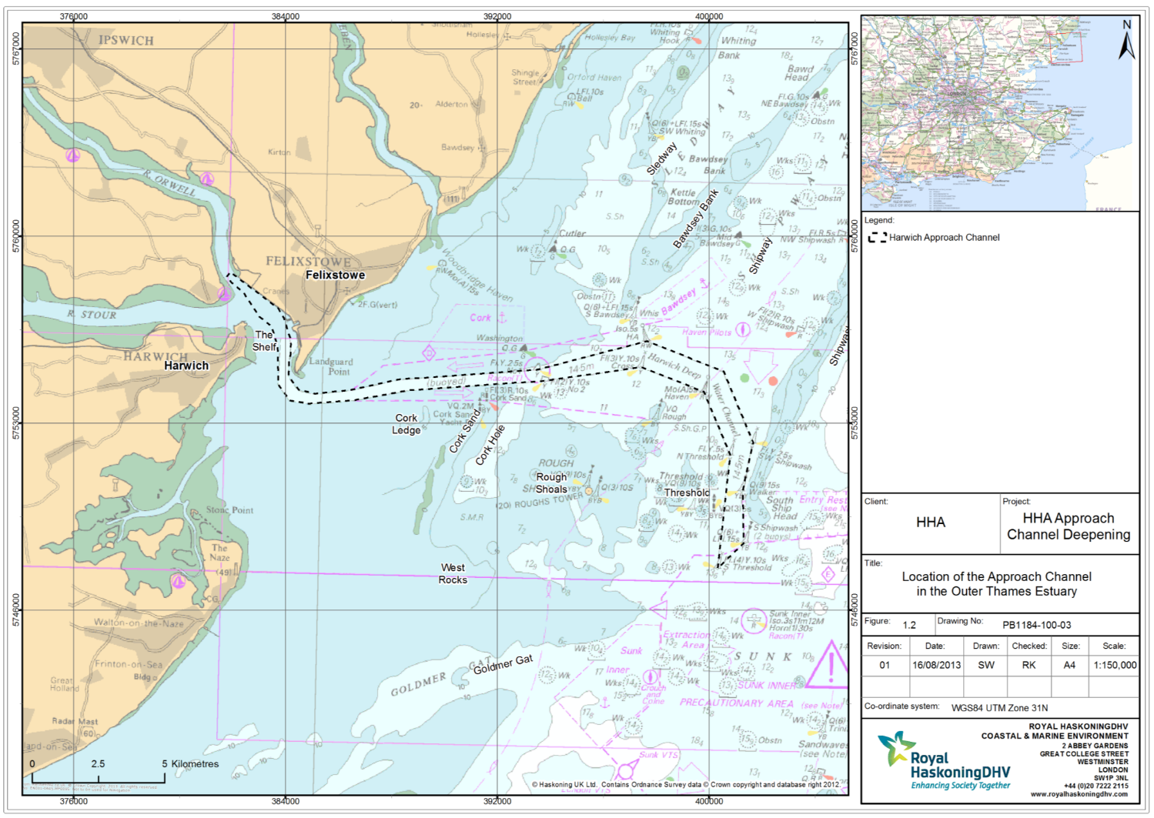
Harbour and channel is currently dredged to -14.5m CD and covers about 17.7M m ³

Slide 6
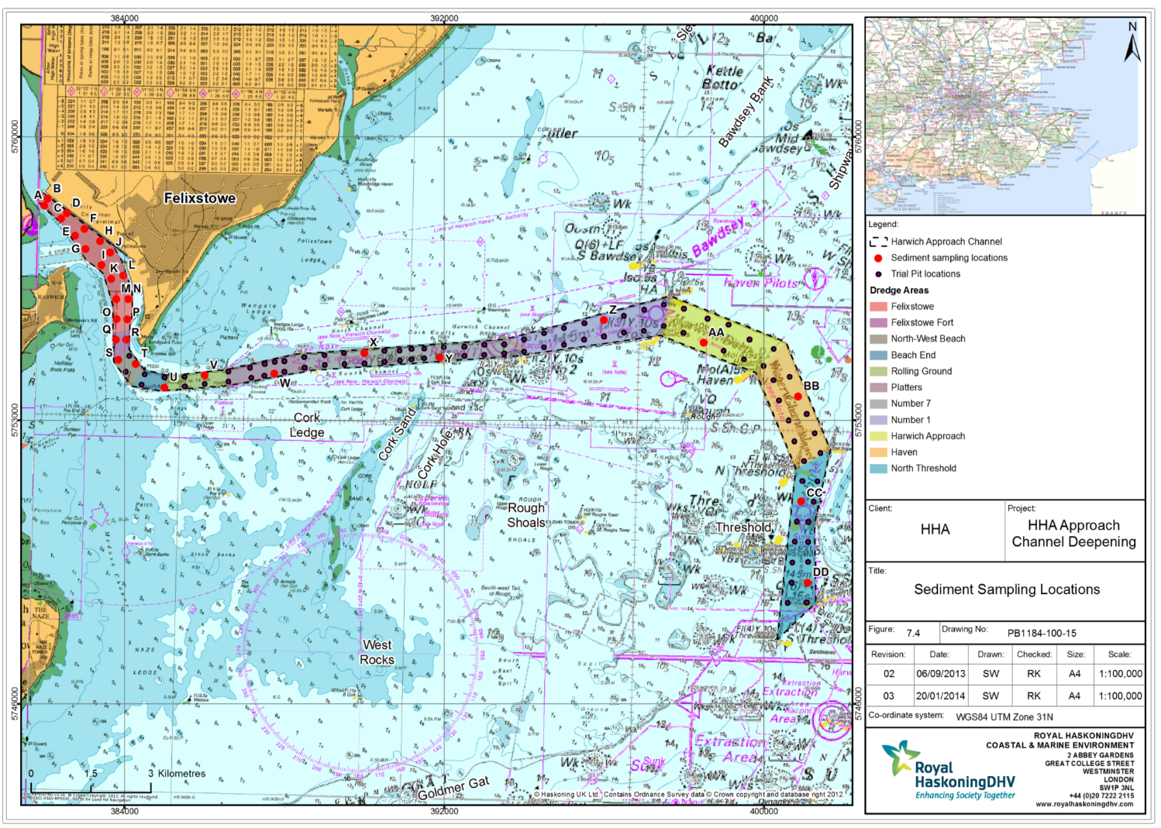
Location of trial pit sampling points

Slide 7
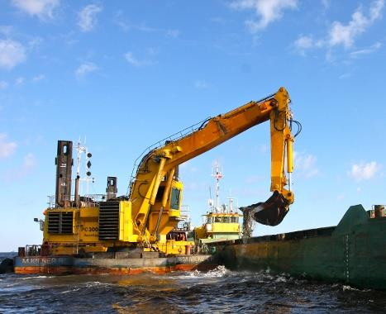
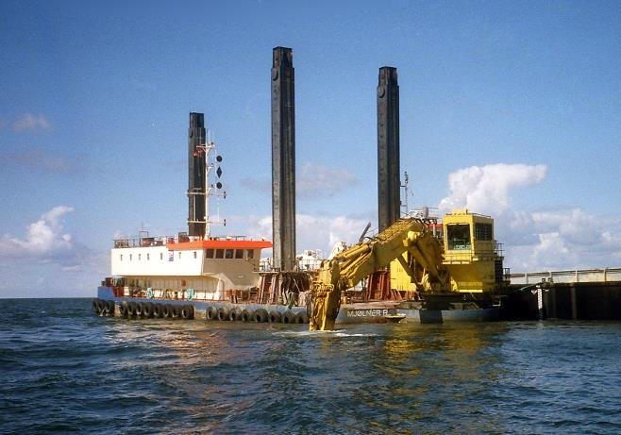
Backhoe Dredger:
Mjølner R

Slide 8
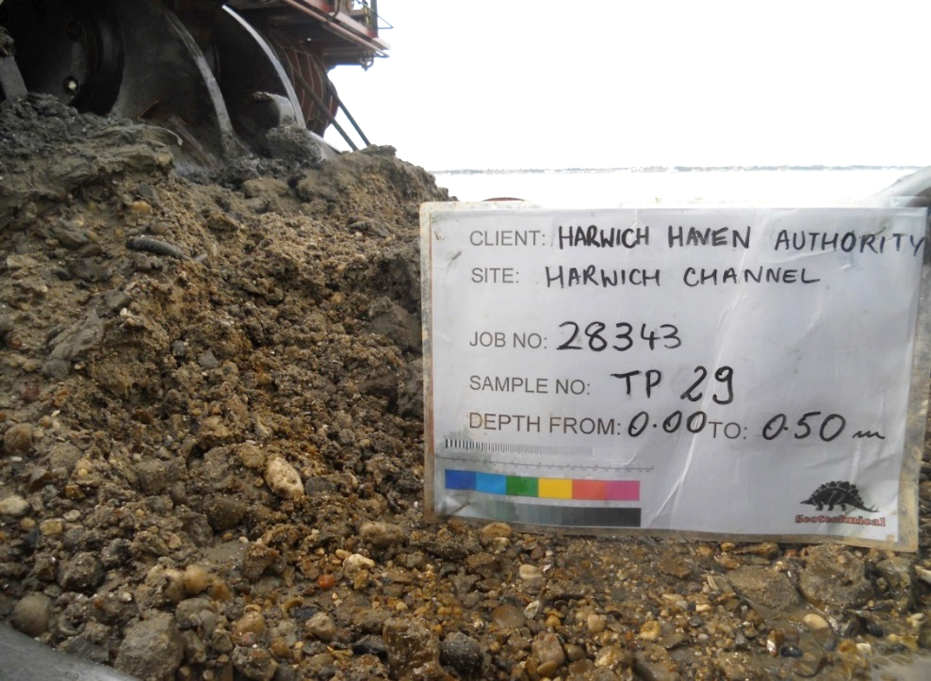
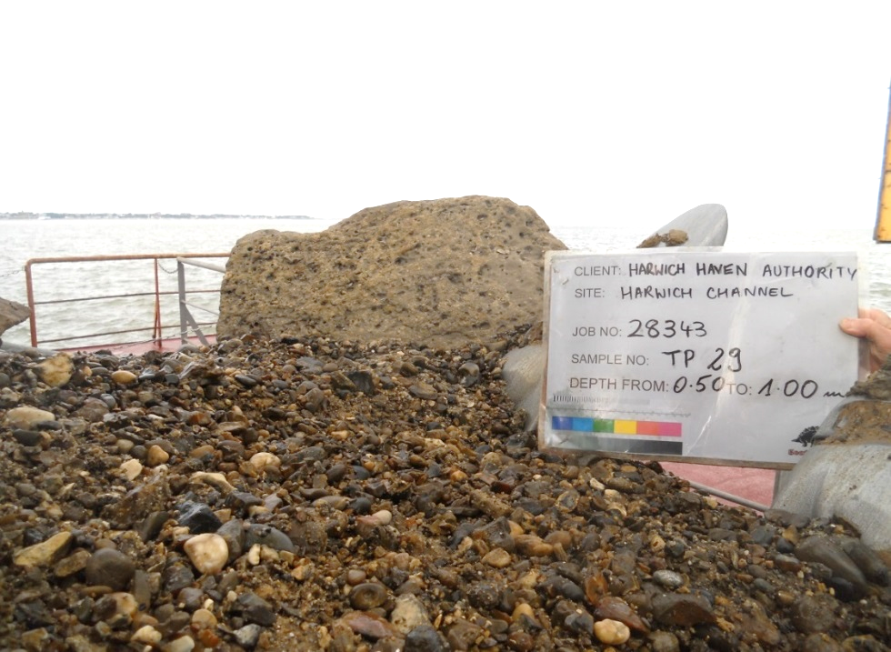
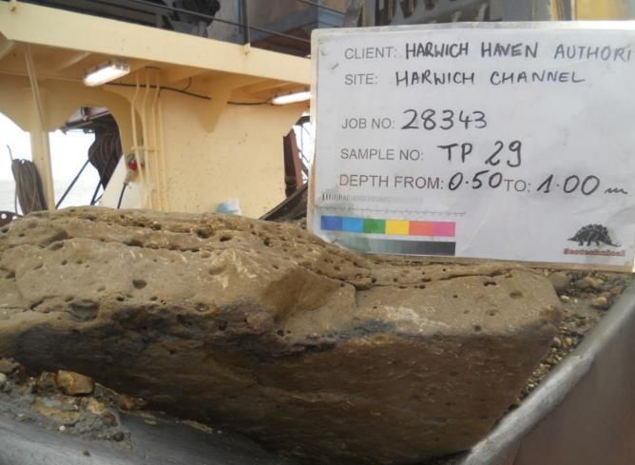

Slide 9
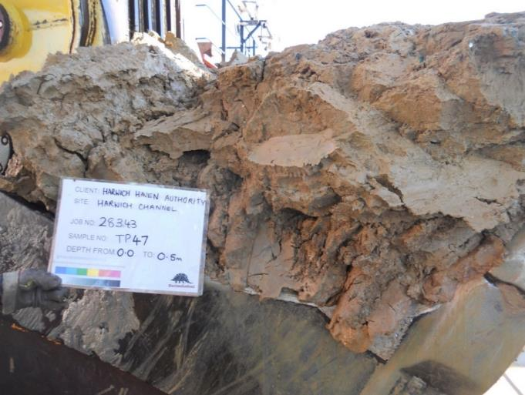
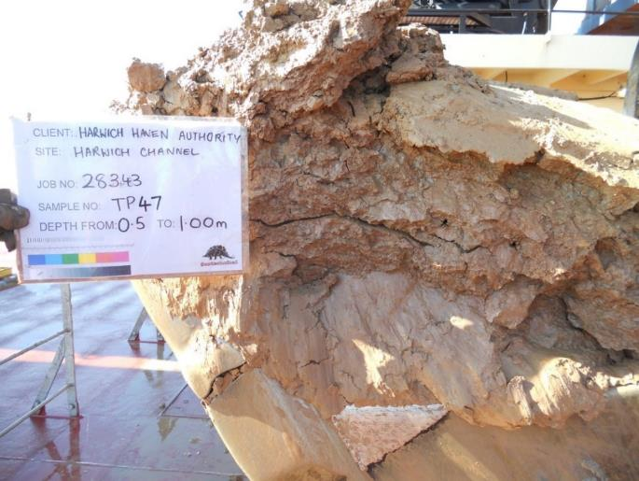
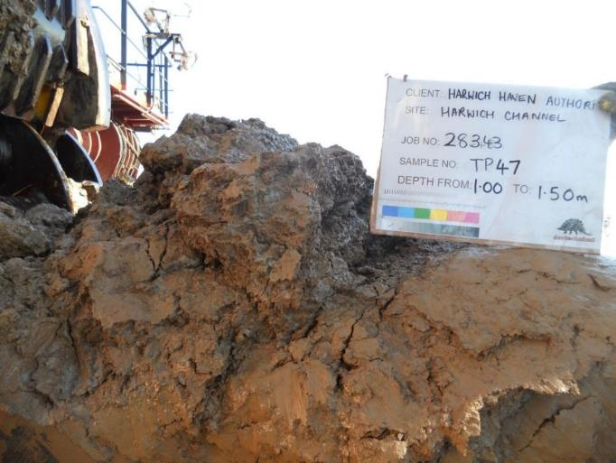

Slide 10
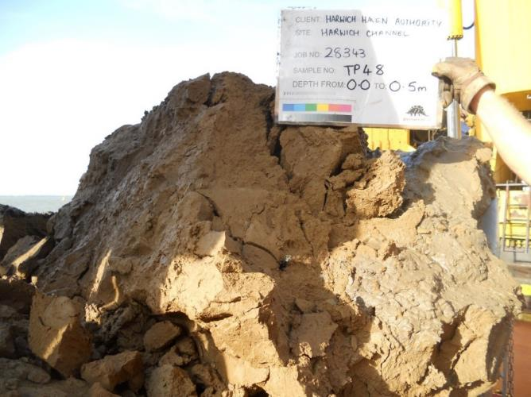
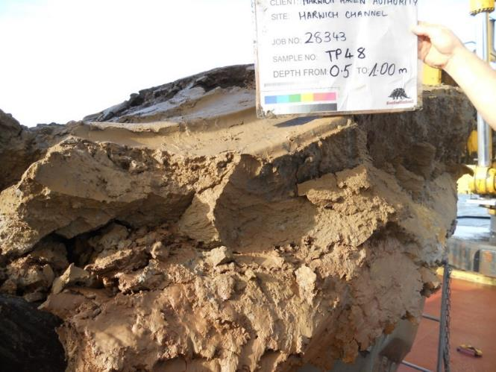
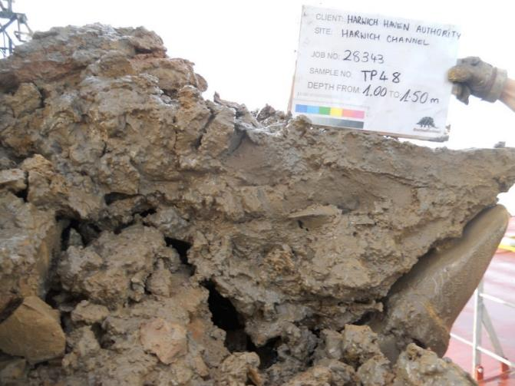
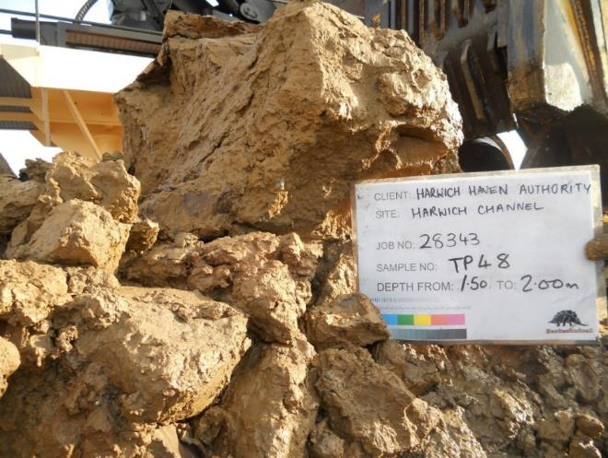

Slide 11
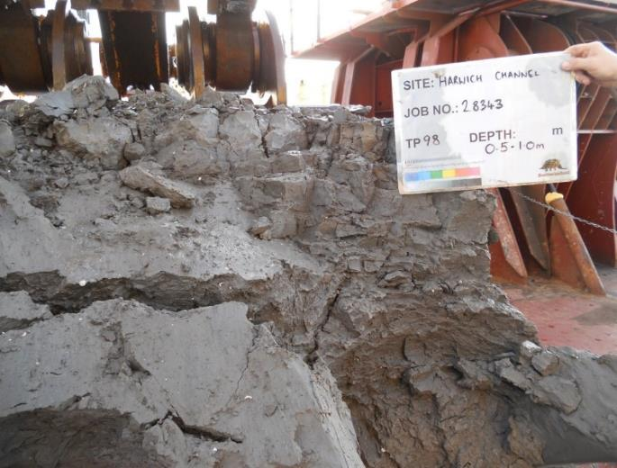
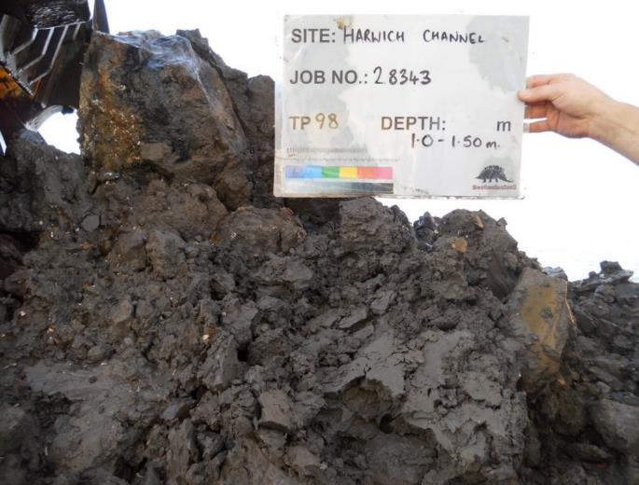
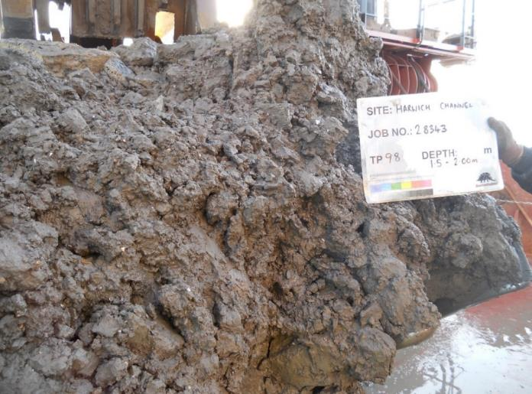

Slide 12
An initial (and approximate) assessment of the materials above the dredge level has been made, dividing the soils into ‘hard clays’, ‘soft clays’ and ‘sand / gravel’ mixtures…
Dredge depth |  | Hard clays | Soft clays | Sand and gravel |  | Total dredge volume
15.5m CD |  | 11.7 M m³ | 0.8 M m³ | 2.9 M m³ |  | 15.4 M m³
16.0m CD |  | 17.7 M m³ | 1.7 M m³ | 4.8 M m³ |  | 24.2 M m³

Slide 13
An initial (and approximate) assessment of the materials above the dredge level has been made, dividing the soils into ‘hard clays’, ‘soft clays’ and ‘sand / gravel’ mixtures…
Dredge depth |  | Hard clays | Soft clays | Sand and gravel | ‘Available’ sand and gravel | Total dredge volume
 |  |  |  |  | ( 50%)
15.5m CD |  | 11.7 M m³ | 0.8 M m³ | 2.9 M m³ | 1.5 M m³ | 15.4 M m³
16.0m CD |  | 17.7 M m³ | 1.7 M m³ | 4.8 M m³ | 2.4 M m³ | 24.2 M m³

Slide 14
As part of the MMO pre-application process, HHA is required to consider beneficial uses;
Seek information from stakeholders regarding existing projects that could benefit from dredged material
Provide further information as available regarding amounts and type of material
Consider if / how these projects could use the dredged material

Slide 15
The pre-application process is about to be launched and the Scoping Report submitted to the MMO
The studies and the various environmental assessments are planned to be completed by March 2015
Beneficial disposal options are likely to be considered in the third quarter of 2014
Proposals and information regarding existing projects should be sent to HHA by the end of June 2014

Slide 16
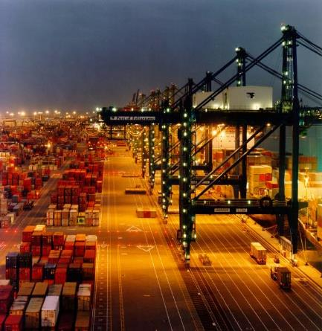
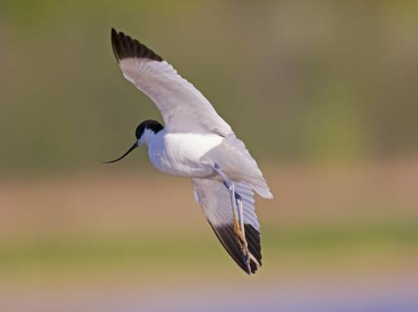
John Brien (Harbour Engineer)
Harwich Haven Authority
Harbour House
The Quay
Harwich Essex
CO12 3HH
01255 243030
Harbour.Engineer@hha.co.uk

